Slide 1
Ensemble Methods For Classification Algorithms
TechCoreEasy
Speaker : Mahavir Teraiya

Slide 2
Agenda:
TechCoreEasy
What Is Ensemble Method ?
Types Of Ensemble Methods
What is Bagging & How it works ?
What is Boosting & How it works ?
What is Random Forest & How it works ?
Pros/Cons of Ensemble Method .
Applications.
Quick Recap

Slide 3









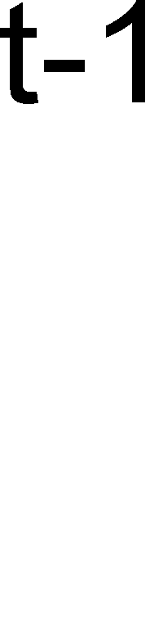










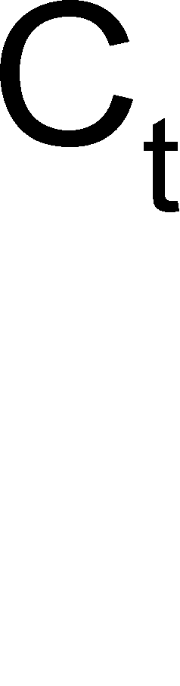
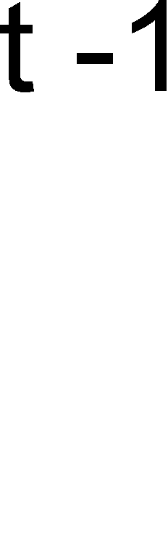




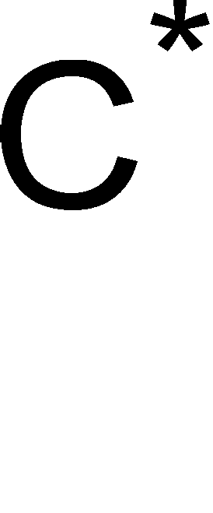




TechCoreEasy
What Is Ensemble Method ?
Construct a set of classifiers from the training data.
Predict class label of previously unseen records by aggregating predictions made by multiple classifiers.

Slide 4
TechCoreEasy
Types Of Ensemble Methods.
Bagging
Boosting
Random Forest

Slide 5
TechCoreEasy
What is Bagging? (Bootstrap Aggregation)
Analogy: Diagnosis based on multiple doctors’ majority vote
Training
Given a set D of d tuples, at each iteration i, a training set D_{i} of d tuples is sampled with replacement from D (i.e., bootstrap)
A classifier model M_{i} is learned for each training set D_{i}
Classification: classify an unknown sample X Each classifier Mi returns its class prediction
The bagged classifier M* counts the votes and assigns the class with the most votes to X
Prediction: can be applied to the prediction of continuous values by taking the average value of each prediction for a given test tuple

Slide 6
TechCoreEasy
Combining predictions by voting/averaging Simplest way
Each model receives equal weight
“Idealized” version:
Sample several training sets of size n
(instead of just having one training set of size n)‏
Build a classifier for each training set Combine the classifiers’ predictions

Slide 7
TechCoreEasy
How & Why Bagging Works ?
Bagging works because it reduces variance by voting/averaging
Note: in some pathological hypothetical situations the overall error might increase
Usually, the more classifiers the better
Problem: we only have one dataset!
Solution: generate new ones of size n
by Bootstrap, i.e., sampling from it with replacement
Can help a lot if data is noisy
Can also be applied to numeric prediction
Aside: bias-variance decomposition originally only known for numeric prediction

Slide 8
TechCoreEasy
Bagging classifiers
Model generation
Let n be the number of instances in the training data For each of t iterations:
Sample n instances from training set
(with replacement)‏
Apply learning algorithm to the sample Store resulting model
Classification
For each of the t models:
Predict class of instance using model Return class that is predicted most often

Slide 9
TechCoreEasy
When does Bagging work?
Learning algorithm is unstable, if small changes to the training set cause large changes in the learned classifier
If the learning algorithm is unstable, then Bagging almost always improves performance
Bagging stable classifiers is not a good idea
Which ones are unstable?
Neural nets, decision trees, regression trees, linear regression
Which ones are stable? K-nearest neighbors

Slide 10
Bagging with costs
TechCoreEasy
Bagging unpruned decision trees known to produce good probability estimates
Where, instead of voting, the individual classifiers' probability estimates are averaged
Note: this can also improve the success rate
Can use this with minimum-expected cost approach for learning problems with costs
Problem: not interpretable
MetaCost re-labels training data using bagging with costs and then builds single tree

Slide 11
What is Boosting?
TechCoreEasy
Analogy: Consult several doctors, based on a combination of weighted diagnoses—weight assigned based on the previous diagnosis accuracy
How boosting works?
Weights are assigned to each training tuple A series of k classifiers is iteratively learned
After a classifier Mi is learned, the weights are updated to allow the subsequent classifier, Mi+1, to pay more attention to the training tuples that were misclassified by Mi
The final M* combines the votes of each individual classifier, where the weight of each classifier's vote is a function of its accuracy
The boosting algorithm can be extended for the prediction of continuous values
Comparing with bagging: boosting tends to achieve greater accuracy, but it also risks overfitting the model to misclassified data

Slide 12
What is the Basic Idea Of Boosting?
TechCoreEasy
Suppose there are just 5 training examples {1,2,3,4,5}
Initially each example has a 0.2 (1/5) probability of being sampled
1st round of boosting samples (with replacement) 5 examples:
{2, 4, 4, 3, 2} and builds a classifier from them
Suppose examples 2, 3, 5 are correctly predicted by this classifier, and examples 1, 4 are wrongly predicted:
Weight of examples 1 and 4 is increased, Weight of examples 2, 3, 5 is decreased
2nd round of boosting samples again 5 examples, but now examples 1 and 4 are more likely to be sampled
And so on … until some convergence is achieved

Slide 13
TechCoreEasy
Also uses voting/averaging
Weights models according to performance
Iterative: new models are influenced by the performance of previously built ones
Encourage new model to become an “expert” for instances misclassified by earlier models
Intuitive justification: models should be experts that complement each other
Several variants
Boosting by sampling,
the weights are used to sample the data for training
Boosting by weighting,
the weights are used by the learning algorithm

Slide 14
AdaBoost.M1
TechCoreEasy
Model generation
Assign equal weight to each training instance For t iterations:
Apply learning algorithm to weighted dataset,
store resulting model
Compute model’s error e on weighted dataset If e = 0 or e ≥ 0.5:
Terminate model generation
For each instance in dataset:
If classified correctly by model: Multiply instance’s weight by e/(1-e)‏
Normalize weight of all instances
Classification
Assign weight = 0 to all classes For each of the t (or less) models:
For the class this model predicts
add –log e/(1-e) to this class’s weight Return class with highest weight

Slide 15
TechCoreEasy
What is a Random Forest?
Random forests (RF) are a combination of tree predictors
Each tree depends on the values of a random vector sampled independently and with the same distribution for all trees in the forest
The generalization error of a forest of tree classifiers depends on the strength of the individual trees in the forest and the correlation between them
Using a random selection of features to split each node yields error rates that compare favorably to Adaboost, and are more robust with respect to noise

Slide 16
How do Random Forests Work ?
TechCoreEasy
D = training set
k = nb of trees in forest
F = set of tests
n = nb of tests
for i = 1 to k do:
build data set Di by sampling with replacement from D
learn tree Ti (Tilde) from Di:
at each node:
choose best split from random subset of F of size n
allow aggregates and refinement of aggregates in tests
make predictions according to majority vote of the set of k trees.

Slide 17
Properties of Random Forests
TechCoreEasy
Easy to use ("off-the-shelve"), only 2 parameters (no. of trees, %variables for split)
Very high accuracy
No overfitting if selecting large number of trees (choose high)
Insensitive to choice of split% (~20%)
Returns an estimate of variable importance

Slide 18
Summary of Random Forests
TechCoreEasy
Random forests are an effective tool in prediction.
Forests give results competitive with boosting and adaptive bagging, yet do not progressively change the training set.
Random inputs and random features produce good results in classification- less so in regression.
For larger data sets, we can gain accuracy by combining random features with boosting.

Slide 19
TechCoreEasy
Advantages
Intuitively, ensembles allow the different needs of a difficult problem to be handled by hypotheses suited to those particular needs.
Mathematically, ensembles provide an extra degree of freedom in the classical bias/variance tradeoff, allowing
solutions that would be difficult (if not impossible) to reach with only a single hypothesis.
They’re unlikely to overfit.

Slide 20
TechCoreEasy
Disadvantages
The model that is closest to the true data generating process will always be best and will beat most ensemble methods. So if the data come from a linear process, linear models will be much superior to ensemble models.
Ensemble models suffer from lack of interpretability.
Ensemble methods are usually computationally expensive. Therefore, they add learning time and memory constrains to the problem.

Slide 21
TechCoreEasy
Quick Recap

Slide 22

TechCoreEasy

